Slide 1

图灵机－The Halting Problem
Unsolvable Problems
The Halting Problem是最简单的不可解决的问题. You will note that the interesting problems involve loops.
以下是 Javascript 程序段落 (algorithm):
for(quarts=0; quarts<10; quarts++){ liters = quarts/1.05671; alert( quarts+" "+liters); } | green = ON red = amber = OFF while(true){ amber = ON; green = OFF; wait 10 seconds; red = ON; amber = OFF; wait 40 seconds; green = ON; red = OFF; }
limit = prompt("Max Value",""); for(quarts=1;quarts<limit;quarts++){ liters = quarts/1.05671; alert( quarts+" "+liters); }
The first program clearly is a one that will terminate after printing in an alert 10 lines of output.
The second program alerts as many times as indicated by the input.
The last program runs forever.

Slide 2
图灵机－The Halting Problem
The Halting Problem
算法可能包含无限循环，有限循环。算法实现的工作量通常依靠输入的数据。算法可能包括各种数据循环，嵌套循环或者顺序循环。The Halting problem asks the question.
Given a program and an input to the program, determine if the program will eventually stop when it is given that input.
Trial solution
Just run the program with the given input. If the program stops, we know the program stops.
But if the program doesn't stop in a reasonable amount of time, we cannot conclude that it won't stop.
Maybe we didn't wait long enough.

Slide 3
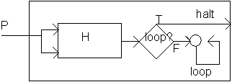
图灵机－The Halting Problem
H能够修改为以P作为输入 (the program and its input) ，而且H应该能够判断是否P在以P作为输入的时候停止下来。
K：一个新的简单算法，takes H's output as its input and does the following
if H outputs "loop" then K halts,
otherwise H's output of "halt" causes K to loop forever.
That is, K will do the opposite of H's output.
function K()
{
if (H()=="loop"){ return “halt"; }
else if (H()==“halt”) { while(true); //loop forever }
}

Slide 4
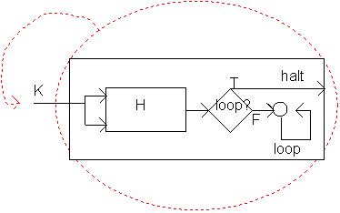
图灵机－The Halting Problem
Since K is a program, let us use K as the input to K.
If H says that K halts then K itself would loop (that's how we constructed it). If H says that K loops then K will halt.
In either case H gives the wrong answer for K. Thus H cannot work in all cases.
如果K 不停机无限循环, 那么它就停机, 输出"halt";
如果 K停机, 那么它就无限循环, 不停机;
这样无论如何我们都将得到一个矛盾, 所以假设前提不成立, 即不存在这样的 H. 或者说, 图灵机停机问题是不可判定的(undecidable).

Slide 5

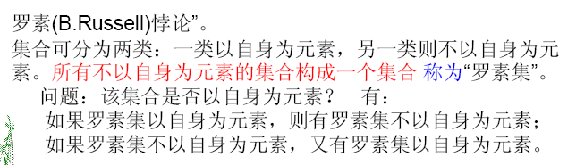
图灵机－停机问题
在現實生活執行電腦時，人們最怕的是電腦進入執行狀態後，一直沒有結果至最後到達Halting狀態，稱之為停機問題。
中止问题(Halting Problem) 是“没法”判断可解的，因为它涉及了“自我参考”，就如集合论里的“罗素悖论”一样。

